Slide 1
Multi-Modal Assistive System for people with disabilities
Team Details
Chithanuru Chandhana(20EG105310)
Kandula Sri Pavani (20EG105323)
Medoju Vamshi Krishna (20EG105328)
Sunchikala Jhansi (20EG105348)
Project Supervisor
Name: G. Kiran Kumar
Designation: Assistant Professor
Department of Computer Science and Engineering

Slide 2
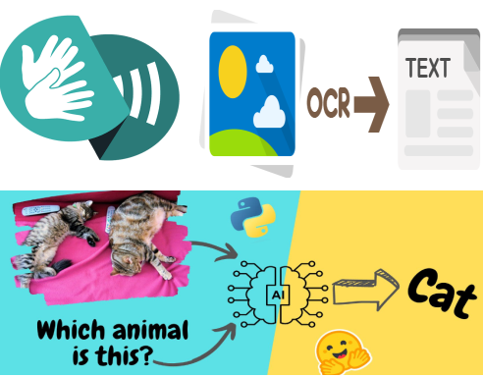
Introduction
Imagine a world where some people struggle to communicate because of visual impairments, hearing loss, or reading difficulties. Millions face this challenge daily, feeling isolated and unheard. But here's a story of hope – a trio of technologies designed to break down these barriers. Visuals to Text helps the visually impaired understand photos and videos, Sign Language Translation turns sign language into spoken words, and Text-to-Speech/Speech-to-Text software gives a voice to those with reading or speaking limitations. This isn't just about tools; it's a plan to create a world where everyone's voice matters. With these technologies, we're rewriting the story of communication, ensuring every voice echoes in our shared world.

Slide 3
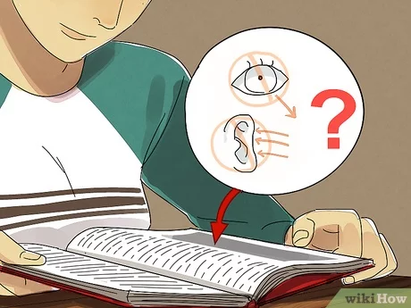
Problem Statement
The current landscape of assistive technologies presents significant challenges due to its fragmented nature. Visuals to Text, Sign Language Translation, and Text-to-Speech/Speech-to-Text tools, though individually beneficial, lack a cohesive framework. This fragmentation results in users grappling with inefficiencies, increased complexity, and potential barriers to widespread adoption. Furthermore, the lack of seamless synchronization between these tools hinders their effectiveness in addressing the diverse needs of individuals with disabilities. Therefore, there is a critical need to develop an integrated assistive technology solution that unifies Visuals to Text, Sign Language Translation, and Text-to-Speech/Speech-to-Text technologies. Such an approach aims to streamline accessibility, enhance user experience, and foster inclusivity for individuals with disabilities, thereby addressing the shortcomings of the existing assistive technology ecosystem

Slide 4
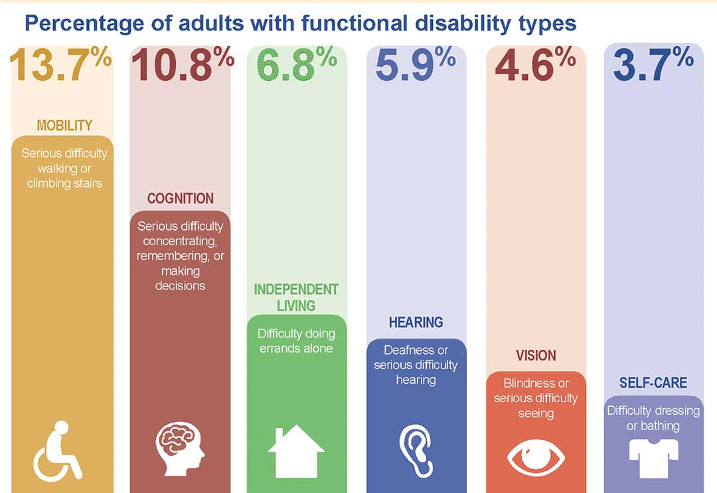
Problem Illustration
Listening and speaking are natural abilities of humans. Unfortunately, there are many people who do not have these abilities and cannot easily communicate with others. The World Health Organization stated that approximately 70 million people in the world are deaf-mutes. A total of 360 million people are deaf, and 32 million of these individuals are children. Also, by 2050, it is expected that one in every four people will face some degree of hearing loss. One of the main problems that deaf-mutes suffer from is communicating with others. Reliance on lip-reading and using sign language interpreters are two solutions for communication between deaf-mutes and non-deaf-mutes. However, lip-reading, in some cases, is useless, especially when the parties of the dialogue need to wear masks. In addition, the usage of sign language interpreters is costly.

Slide 5
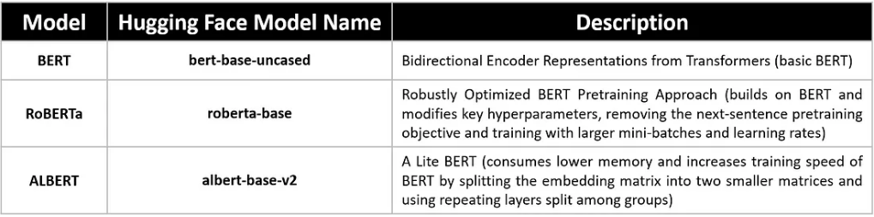
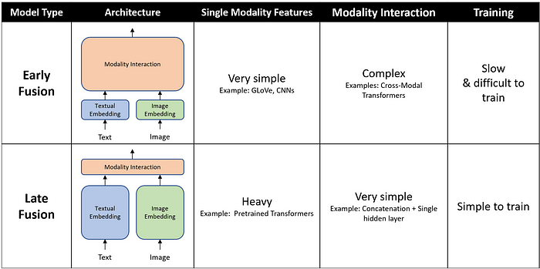
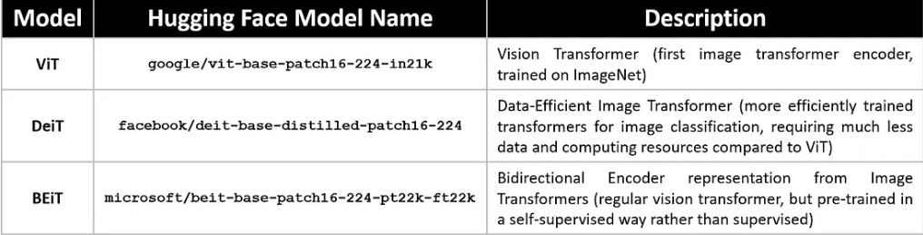
Proposed Method
A trio of technologies designed to break down communication barriers:
Visuals to Text: This technology uses computer vision to convert images and videos into text descriptions, making them accessible to people with visual impairments. The methodology for this feature is multimodal transformers, it involves the following three phases.
i. Featurization of Image and Question
ii. Feature Fusion
iii. Answer generation

Slide 6
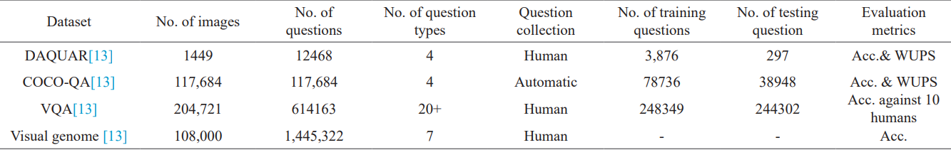
Proposed Method Illustration
Brief Description About Some Well-Known Dataset of VQA

Slide 7
Proposed Method
Sign Language Processing: This module is again divided to two subtasks in order to process word level sign language
speech/text to sign : To convert the text or speech to sign language our methodology consists if the following process
Speech Recognition
Text Segmentation
Sign Matching
Sign Sequence Generation
ii. Text to sign: To convert sign language to text our methodology consists if the following process
Pre-processing
Transfer Learning
Video Frame Classification
Sign Sequence Decoding

Slide 8
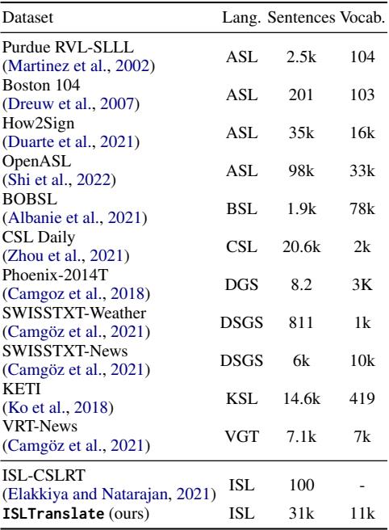
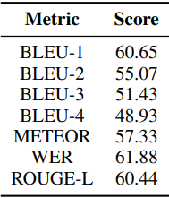
Proposed Method Illustration
translation scores for a random sample of 291 pairs from ISLTranslate when compared to references translated by the ISL instructor.
Comparison of continuous sign language translation datasets.

Slide 9
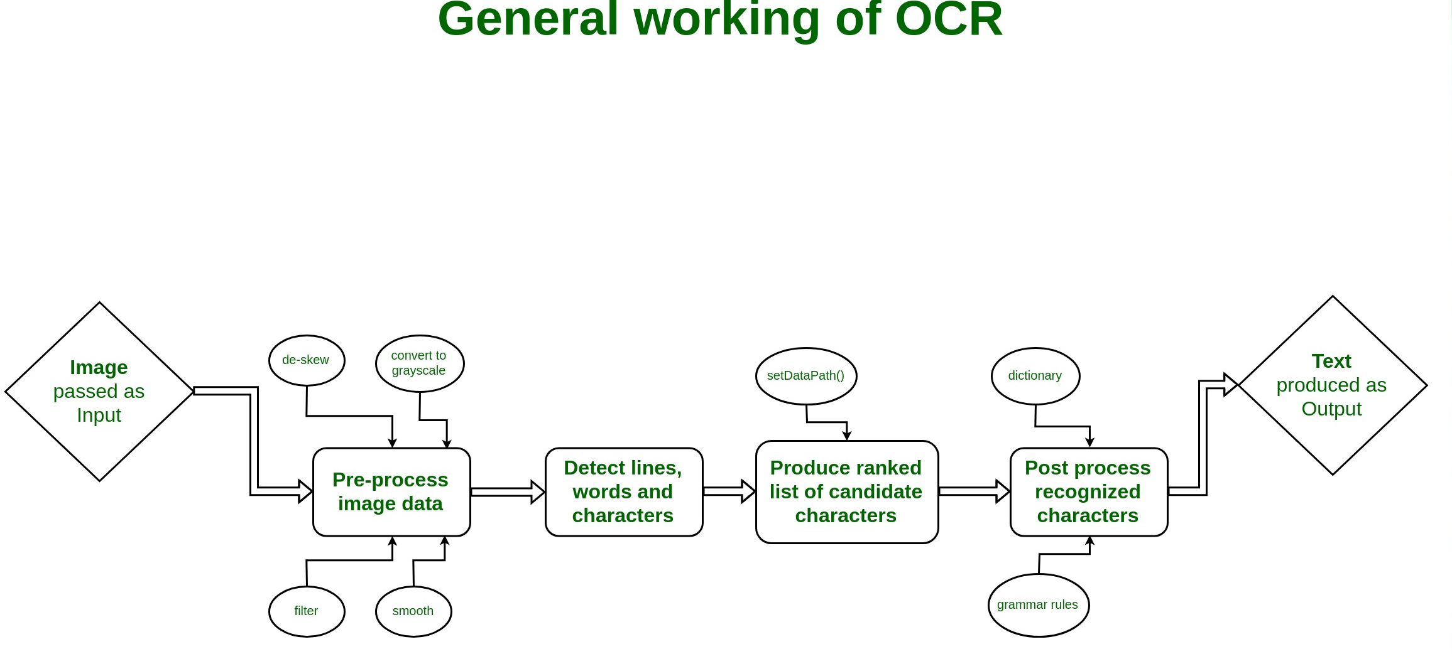
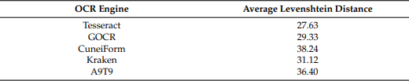
Proposed Method
Text-to-Speech/Speech-to-Text: This technology converts text into spoken words and vice versa, allowing people with reading or speaking difficulties to communicate more effectively. In order to convert image to text we use Optical Character recognition(OCR) method and to convert text to speech , we leverage existing speech recognition and text-to-speech engines through Python.
Proposed Method Illustration
The results of the performance tests conducted for the OCR engines.

Slide 10
Proposed Method
Parameters improved:
Accessibility: These technologies will make communication more accessible to people with disabilities by removing the barriers created by their impairments.
Inclusion: By enabling communication between people with different abilities, these technologies will promote social inclusion and create a more equitable society.
Quality of life: These technologies can improve the quality of life for people with disabilities by helping them to connect with others, participate in education and employment, and live more independently.

Slide 11
Experiment Environment
Operating system: Windows and ubuntu.
Technology Stacks: Python, deep learning, NLP, computer vision.
Frameworks & libraries: TensorFlow, Flask, Pytorch, NumPy, OpenCV, pandas and NLTK, etc.

Slide 12
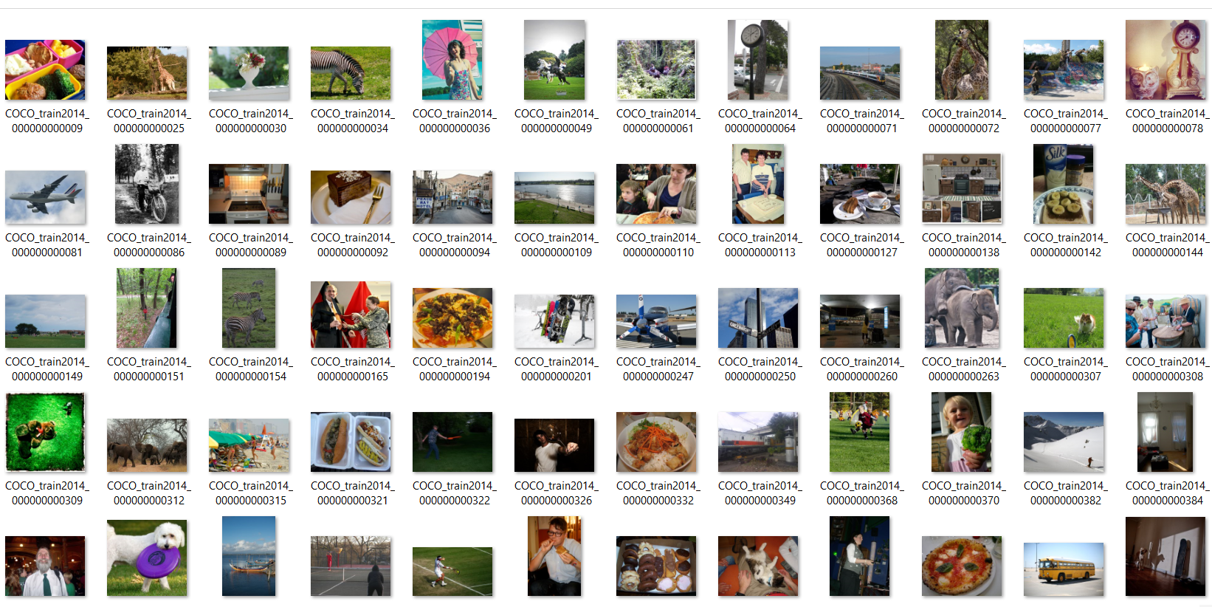
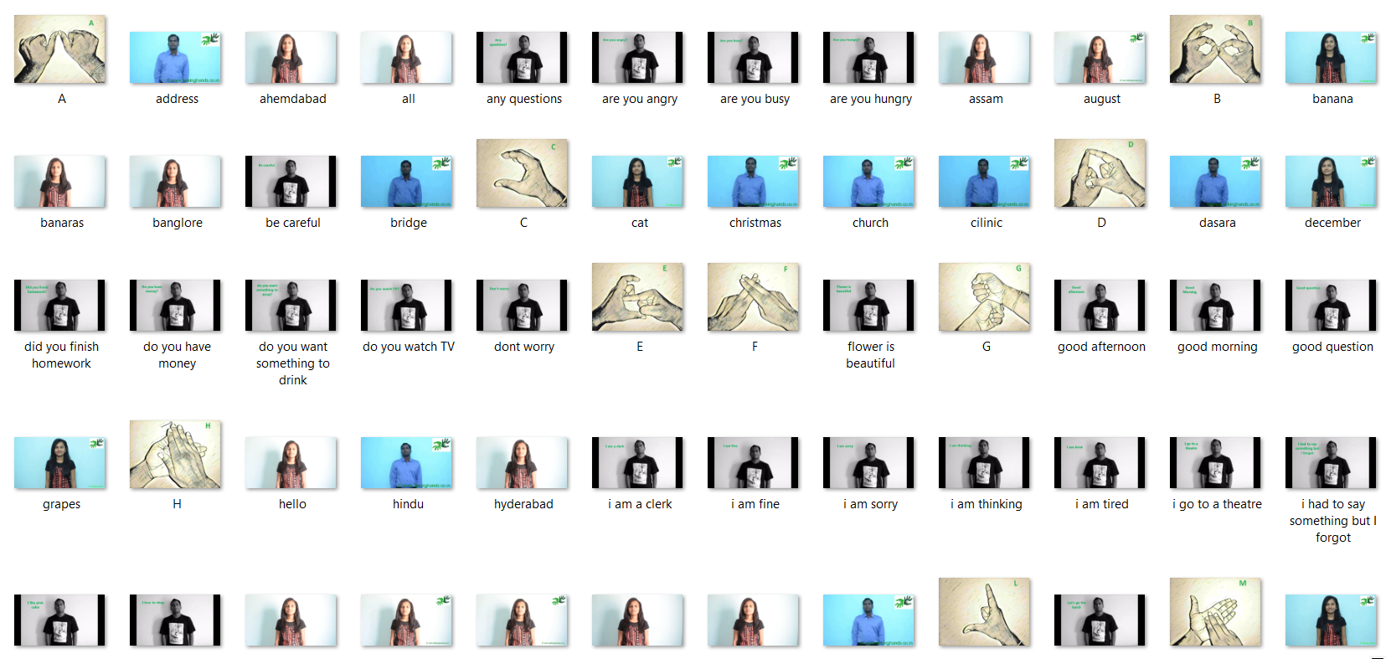
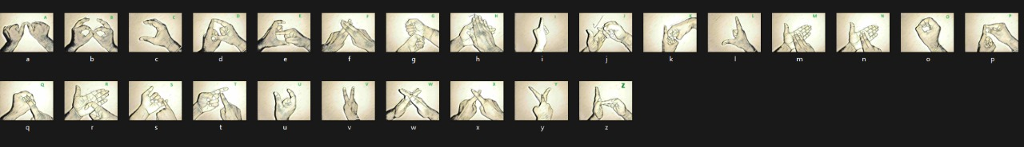
Experiment Environment
Our project tackles two communication tasks: visual question answering and speech-to-sign language translation. For the visual question answering part, we use the COCO-2014 dataset to train the system on understanding image content and answering questions. The text/speech-to-sign language module focuses on Indian Sign Language (ISL) using a dedicated ISL dataset. This allows seamless translation for ISL users.

Slide 13
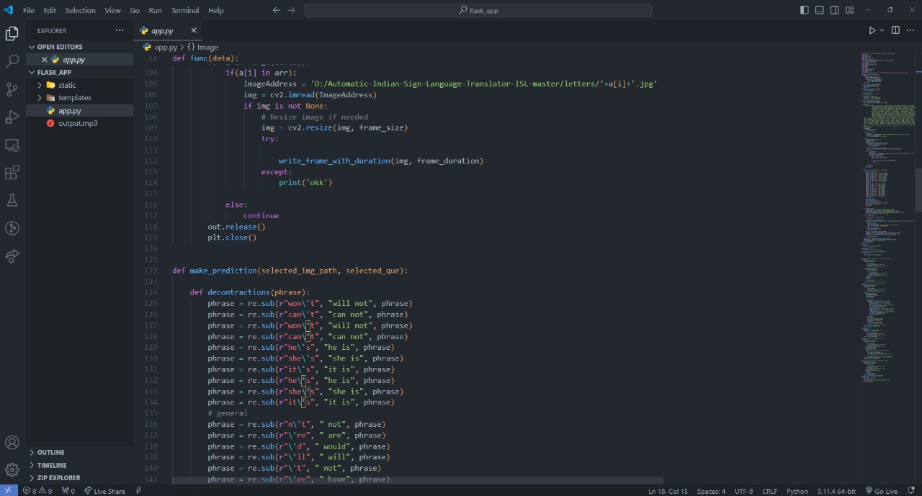
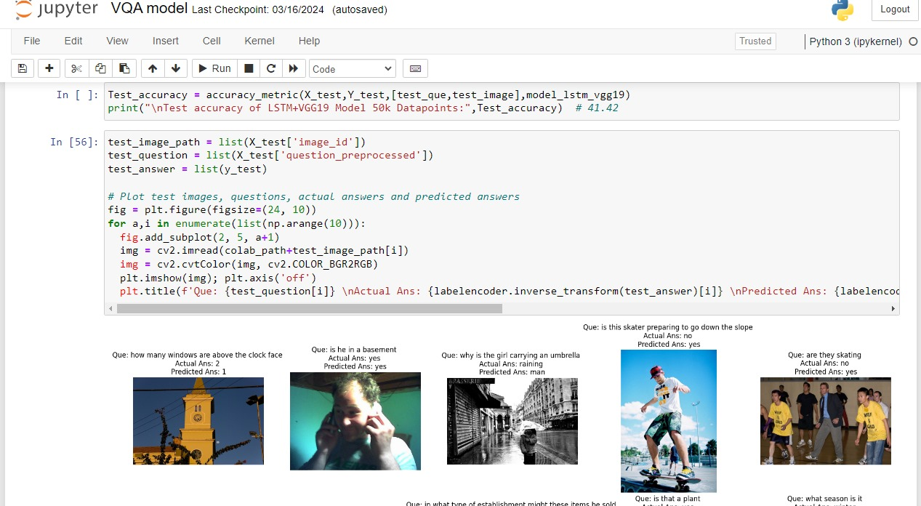
Experiment Environment
Our project benefitted from various coding tools. VS Code provided a user-friendly environment for development, while Jupyter Notebook served well for data exploration and interactive coding. Additionally, Google Colab offered access to powerful cloud resources for computationally intensive tasks like training the deep learning models.

Slide 14
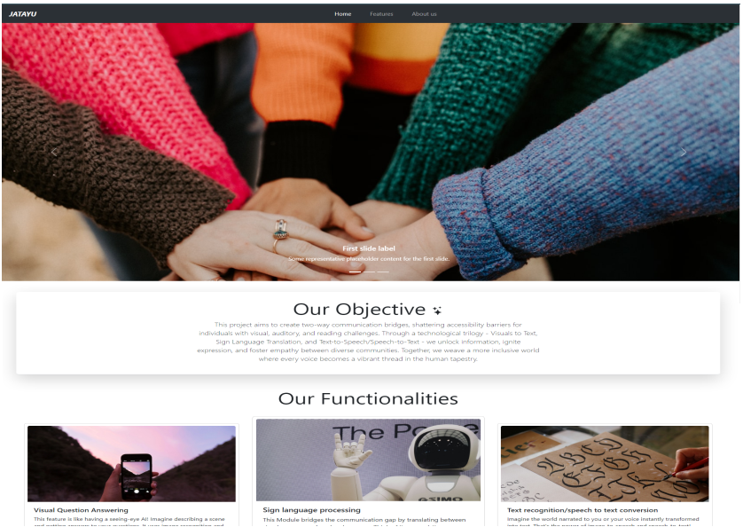

Experiment Screenshots
A web interface integrated with multiple features

Slide 15
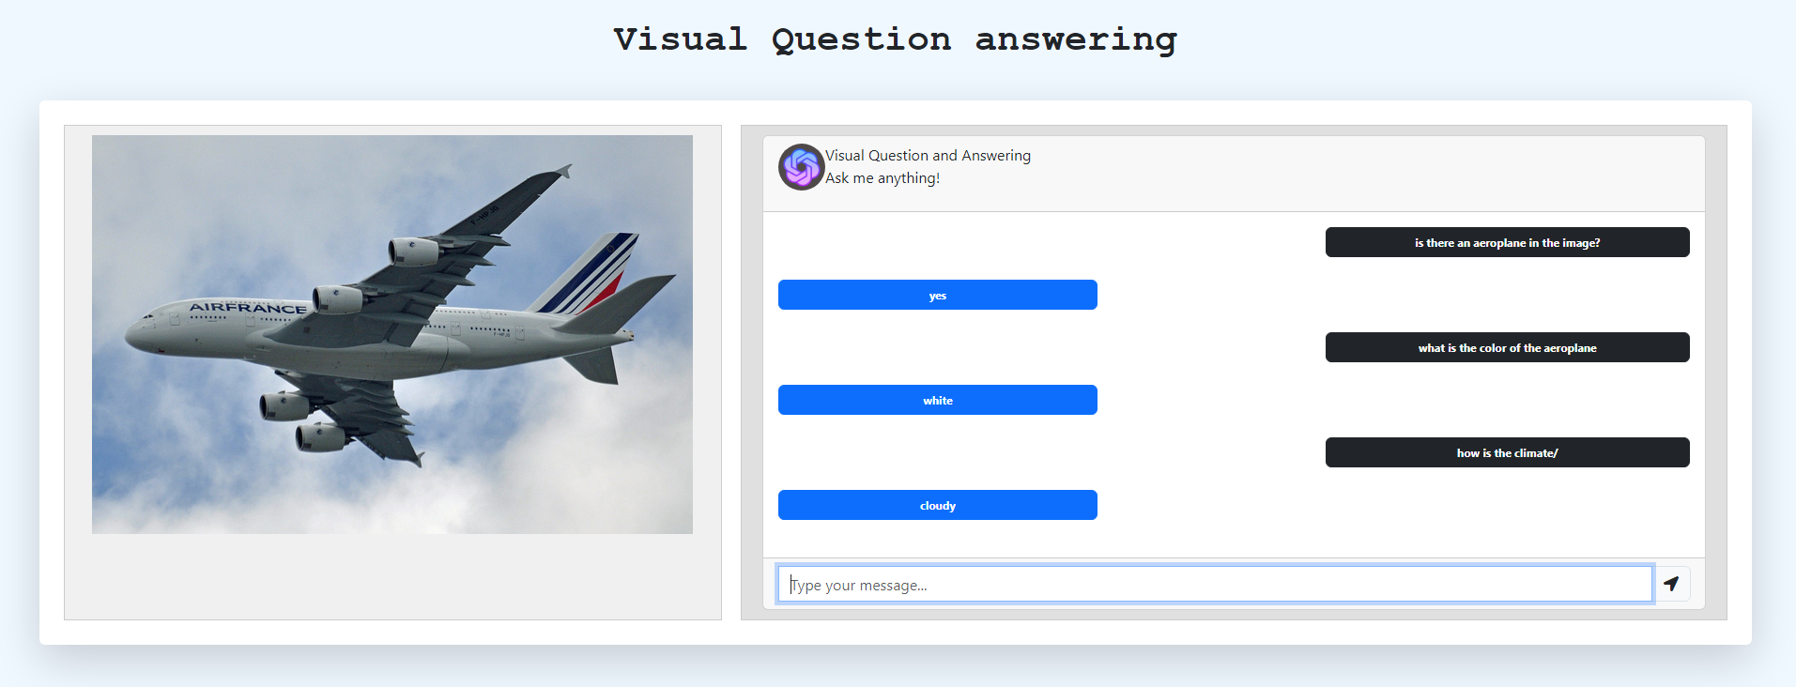
Experiment Screenshots
Visual question and answering

Slide 16
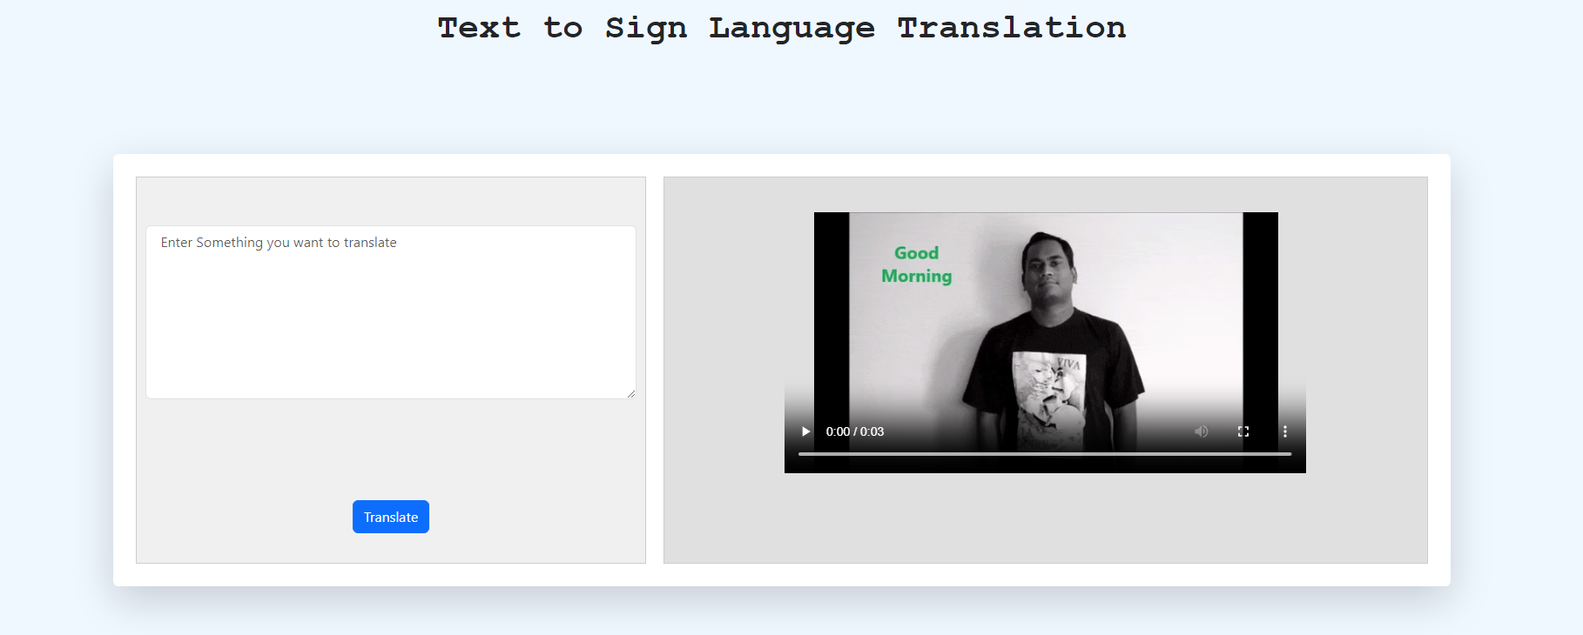
Experiment Screenshots
Text to sign language translator

Slide 17
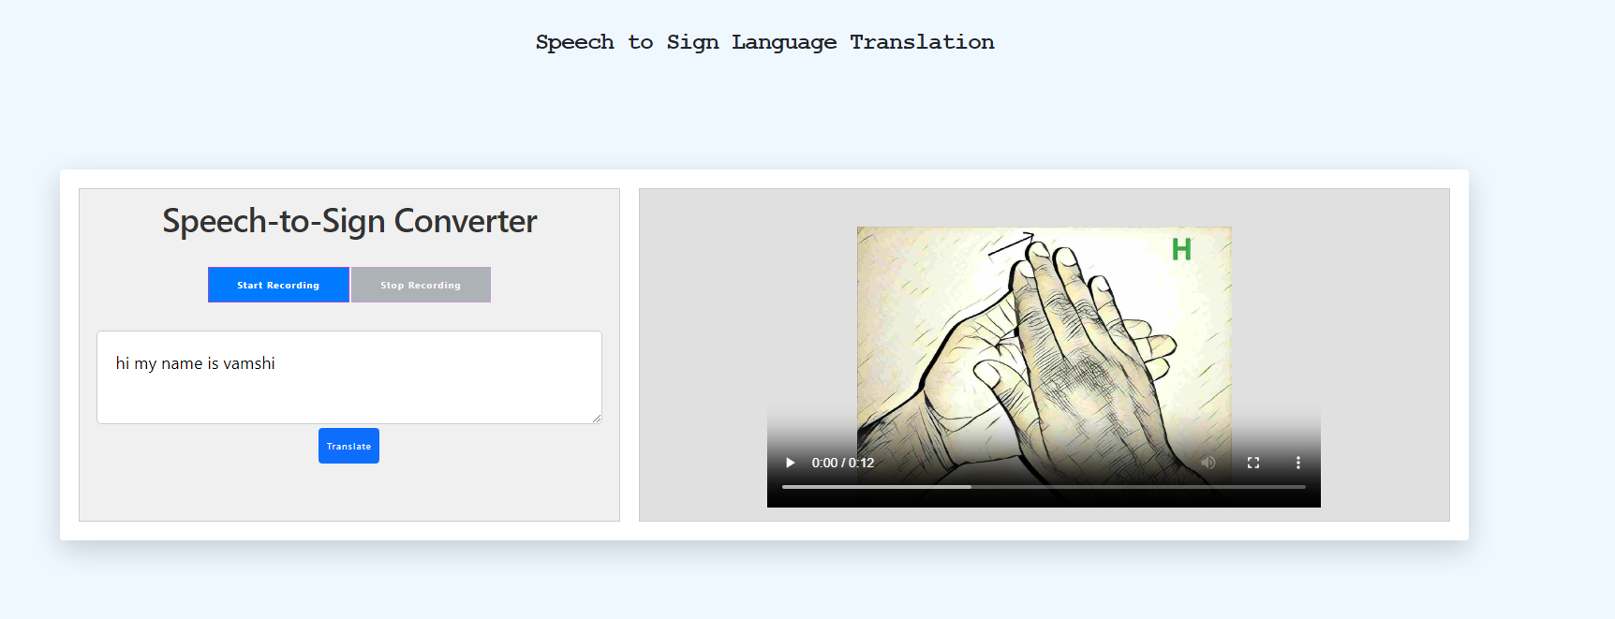
Experiment Screenshots
Speech to sign language translator

Slide 18
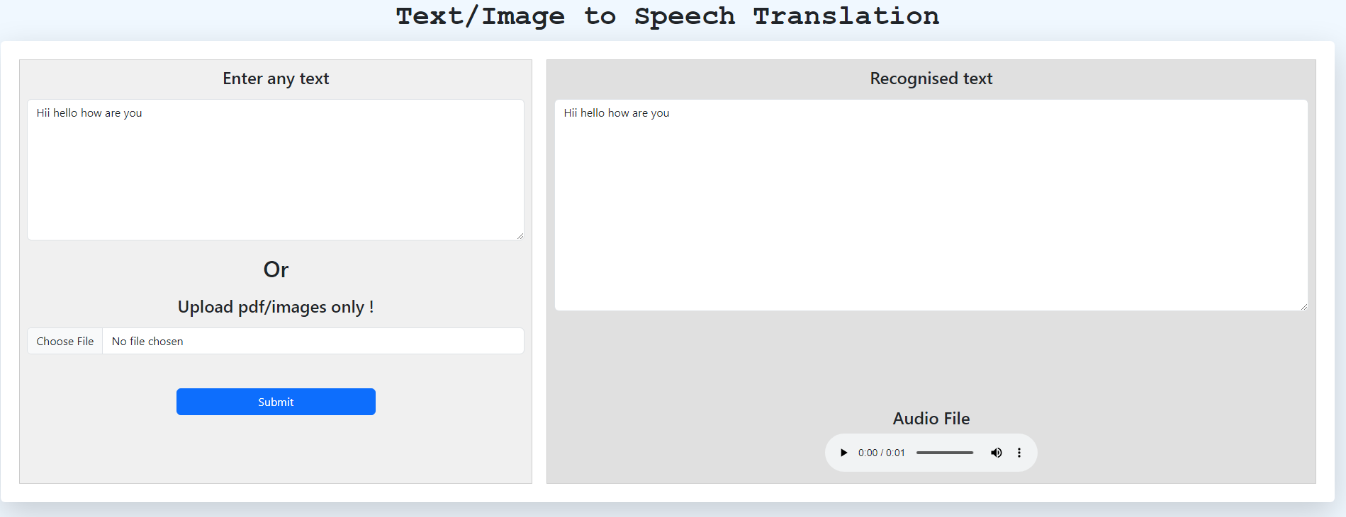
Experiment Screenshots
Text to speech translator

Slide 19
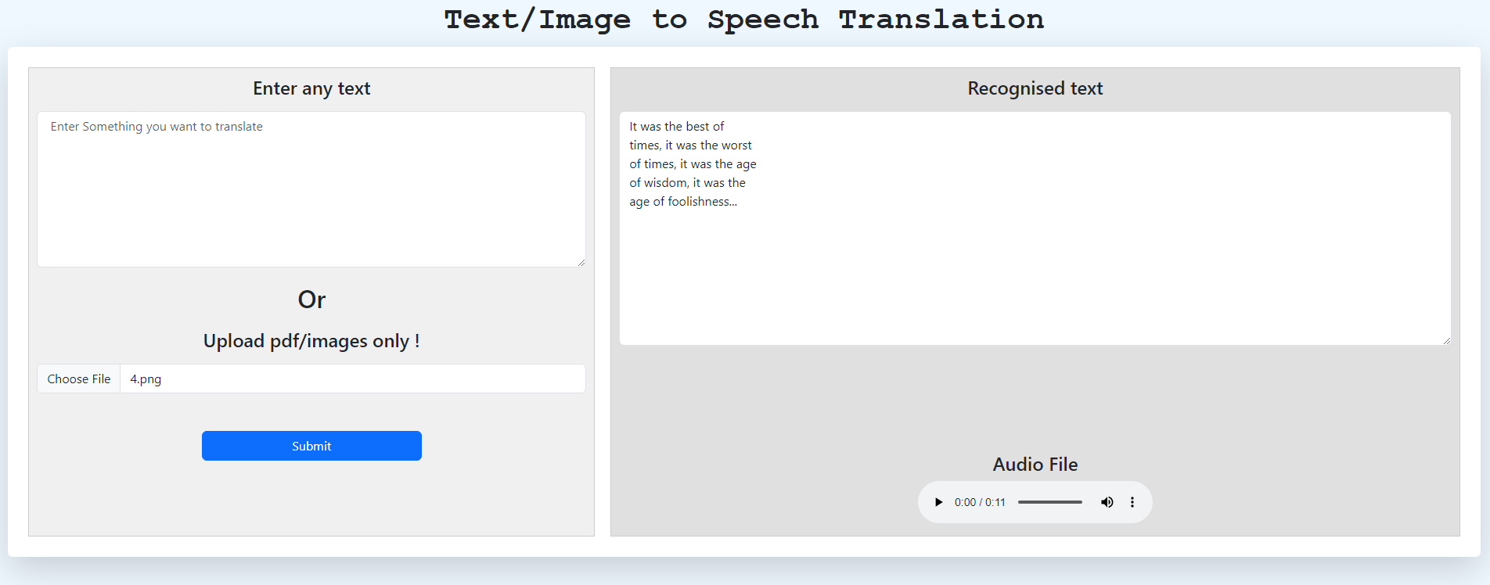
Experiment Screenshots
Image to speech translator

Slide 20
Findings
The proposed method accuracy is increased as we used Pre-processing the Input Image and combination of pytesseract with deep learning for text recognition.
The proposed method is both completeness and time efficient compared to existing system.
The proposed method has highest accuracy with best confidence.

Slide 21
Justification
Parameter | Previous methods | Proposed method
Accuracy (VQA) | In the previously used method, the accuracy is low | The accuracy is increased as we used transformers with customized learning rate and regularization
Accuracy (image to speech) | In the previously used method, the accuracy is low | The accuracy is increased as we used Pre-processing the Input Image combination of pytesseract with deep learning for text recognition
Time | In the previously used method, the generation time of video is low | The generation time of video is fast as we load the videos from the existence
Completeness | In the previously used method, for some sentences they could not generate the complete sign representation | Our method can completely generate any sign video for any sentence as we generate video by combining the individual letters or words of the sign representations

Slide 22
Thank you

Slide 23
Project seminar–I Evaluation
S.No | Rubrics | Marks
1 | Concept Introduction | 4
2 | Literature and Parameter | 5
3 | Problem and Problem Illustration | 8
4 | Proposed Method and Illustration | 8
Total |  | 25

